Slide 1



Concurrent Applications with F# Agents
Twitter #fsharp #codemash
@rachelreese
@fireflylogic
presented by Rachel Reese

Slide 2
What are F# agents?
F#’s implementation of Erlang-style message passing
(also in Clojure, Scala, Elixir (and many others))
[But there are differences.]

Slide 3
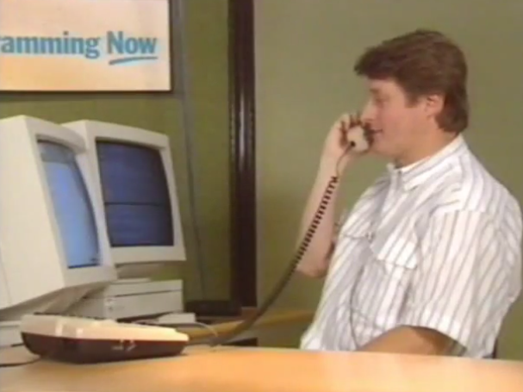
What is Erlang-style message passing?
Hello, Joe!
Erlang’s message passing is based on the actor model devised by Carl Hewitt et al. in 1973.

Slide 4
What is the actor model?
dynamic creation of actors
inclusion of actor addresses in messages
interaction only through direct asynchronous message passing
no restriction on message arrival order

Slide 5
What is an actor?
An actor is an independent computational entity which contains a queue, and receives and processes messages.
Everything
is an
Actor

Slide 6
What can an actor do?
Determine what to do with the next incoming message
Send messages to another actor
Create more actors

Slide 7
“One actor is no actor. They come in systems.”
- Carl Hewitt

Slide 8
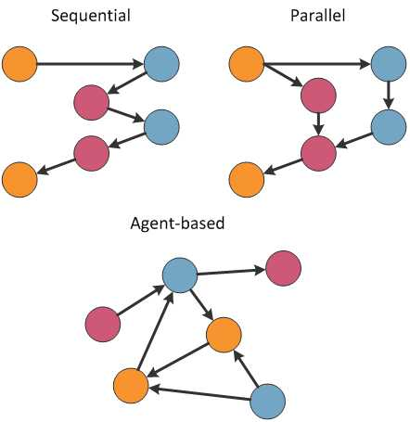
What does a system of actors look like?

Slide 9
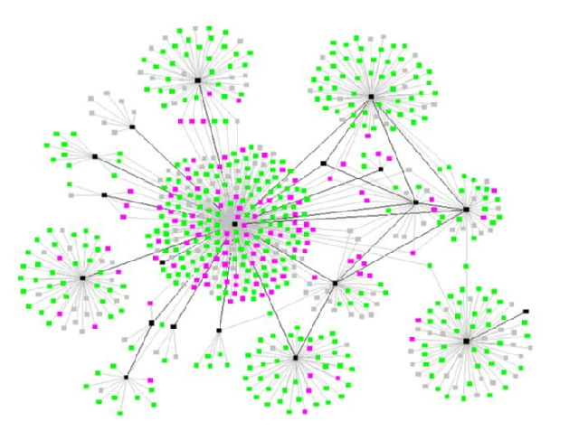
What does a system of actors look like?

Slide 10
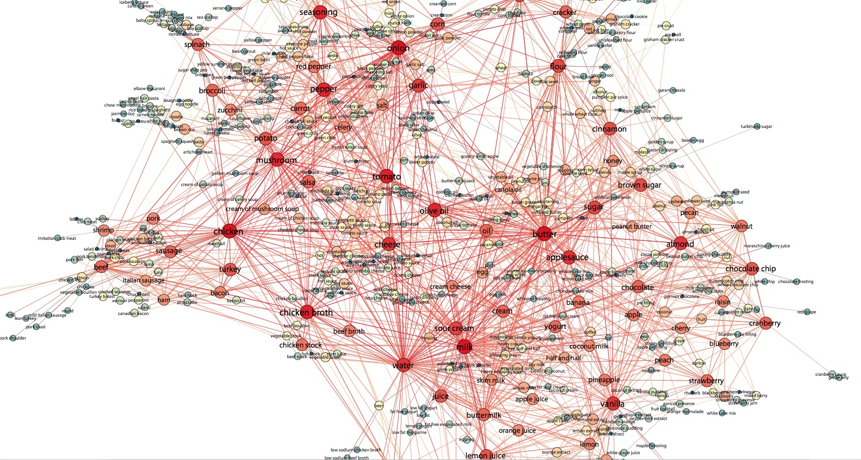
What does a system of actors look like?

Slide 11
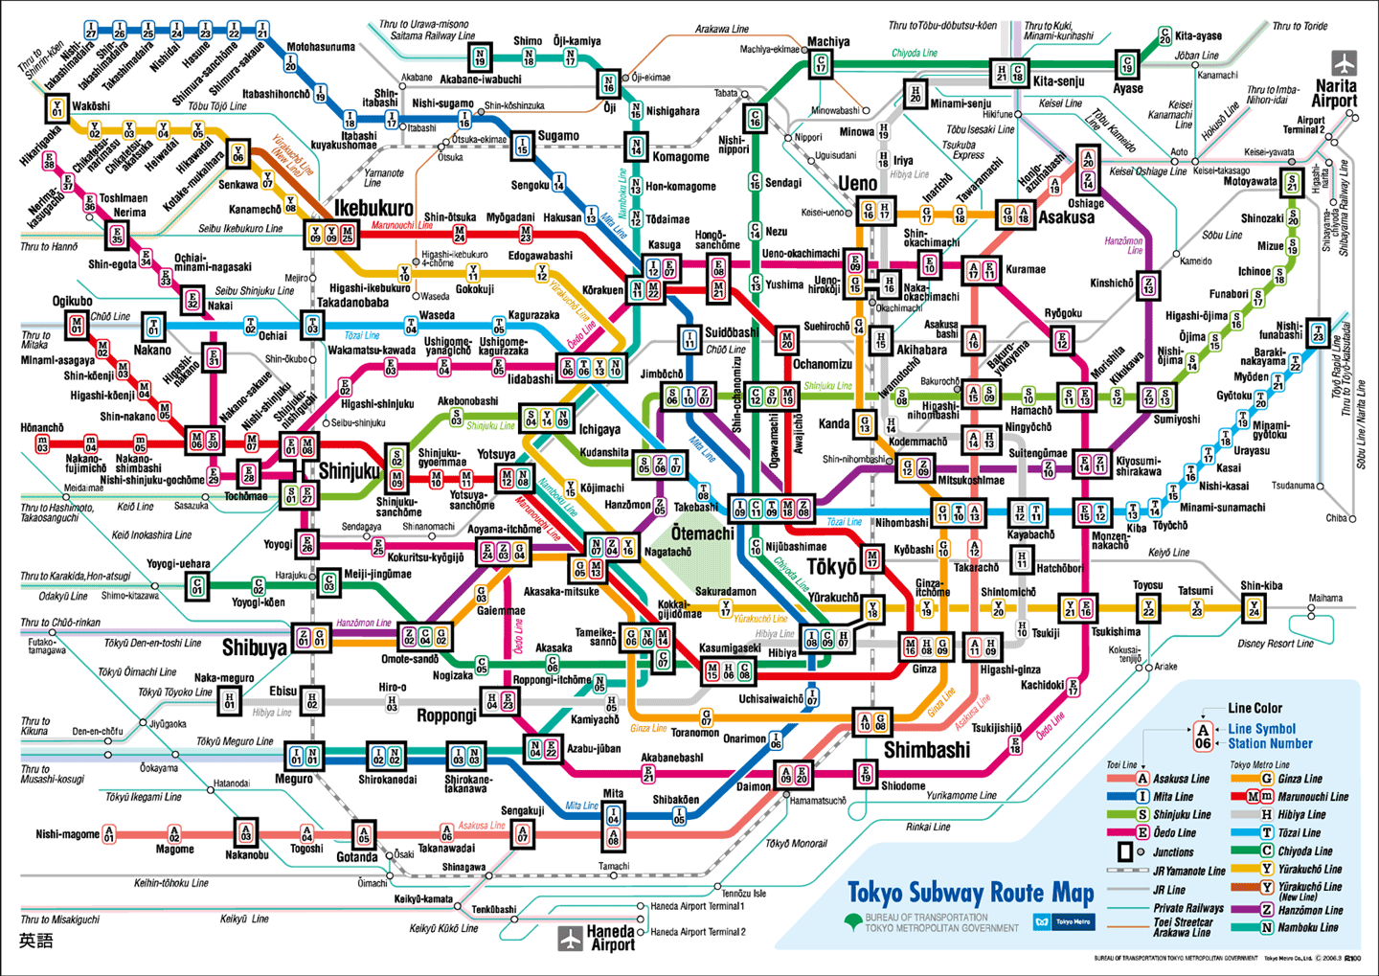
What does a system of actors look like?

Slide 12
What is the actor model?
dynamic creation of actors
inclusion of actor addresses in messages
interaction only through direct asynchronous message passing
no restriction on message arrival order

Slide 13
What are F# agents?
F#’s implementation of Erlang-style message passing
(also in Clojure, Scala, Elixir (and many others))
[But there are differences.]

Slide 14
Definitions
Asynchronous Non-blocking, specifically in reference to I/O operations (not necessarily parallel, can be sequential.)
Concurrent Multiple operations happening at the same time (not necessarily in parallel).
Parallel Multiple operations processed simultaneously.

Slide 15
Demos: Intro, Replies, Scanning, Emailer

Slide 16
What are some major differences between F# agents & Erlang’s message passing?
F# agents are contained in-process; they are not distributed.
Lack of support for supervisors.
No built-in durable mailboxes.

Slide 17
Demo: FSharp.Actor framework

Slide 18
Additional Resources
Actors and Agents
F# in general, and Async, Concurrency, & Parallelism
Fsharp.Actor
TPL Dataflow
ActorFx
Orleans
Hewitt, Meijer, and Szyperski C9
Async and Parallel Design Patterns in F# Agents
An Introduction to Agents
Image pipeline using agents
Building an actor in F# w/ higher throughput than Akka or Erlang
F# MailboxProcessor
Building clean and cohesive concurrent systems with F# agents
Try F#
F# Koans
SkillsMatter
FsSnip
F# Chat on IRC or JabbR
The Hitchhiker’s Guide to Concurrency
F# Asynchronous Programming Model

Slide 19
Thanks!
Rachel Reese
Twitter: @rachelreese
Email: rachel.reese@fireflylogic.com
Firefly Logic, Inc.
1000 Main Street #201 Nashville, TN 37206
http://fireflylogic.com

